Slide 1
Advanced Freehand Drawing with Histogram Matching

Slide 2
Introduction
1)Description of the application
2)Purpose: Freehand drawings with histogram matching
3)Interactive MATLAB environment

Slide 3
Features
Freehand drawing with adjustable brush sizes and colors
Undo and reset functionality
Histogram matching for intensity alignment
Save and load functionality

Slide 4
Application Goals
Create an intuitive drawing interface
Enable histogram matching for enhanced image processing
Provide a modular and reusable codebase

Slide 5
Code Overview
startDrawing: Freehand drawing functionality
match Histogram: Histogram matching
Undo, reset, save, and load functions
Leveraging MATLAB UI components

Slide 6
Workflow
User starts by creating a drawing
Drawing can be saved, reset, or matched with a reference image
Undo feature for revisions
Brush size and color customization

Slide 7
Output - Drawing Interface
Insert screenshot or visual representation of the drawing interface.
Description: Where users can draw, adjust brush size and color, and save or reset their work.

Slide 8
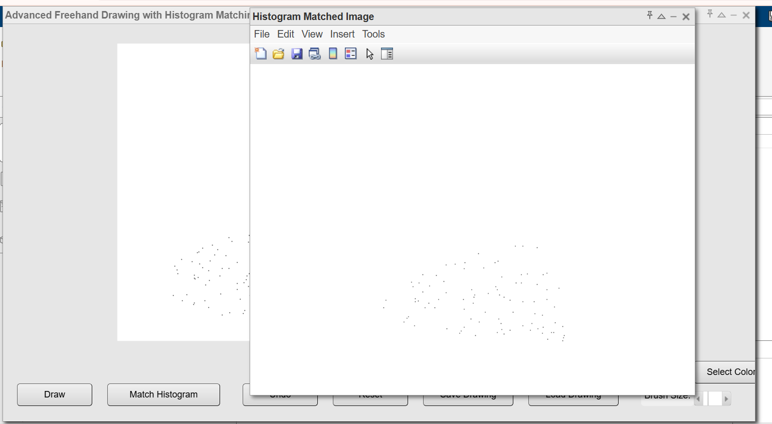
Output - Histogram Matching
visual representation of the histogram matching feature in the code

Slide 9
Challenges Faced
Dynamic brush size and color selection
Efficient image processing within MATLAB
Ensuring a smooth user experience with interactive elements

Slide 10
Future Enhancements
Shape tools for structured drawings
Advanced image filters and transformations
Expanded export options

Slide 11
Conclusion
Summary of project highlights
Future potential

